Slide 1
Most Loved Games
By Kelvin

Slide 2
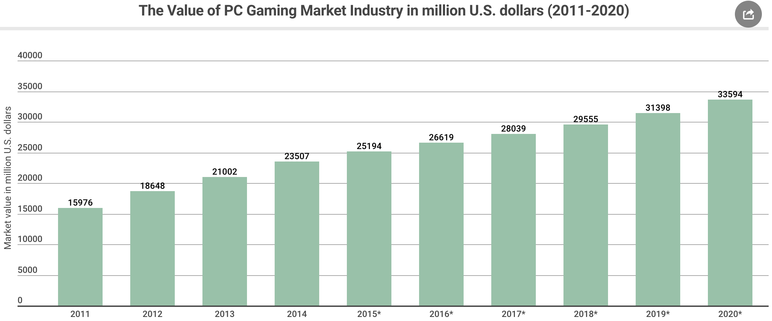
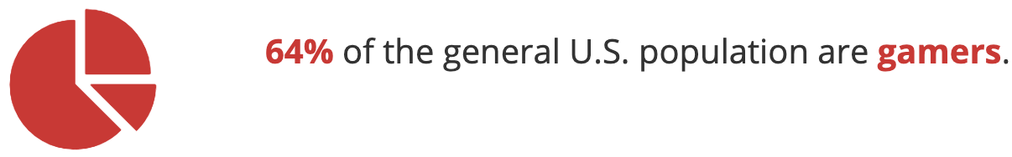
Incentive

Slide 3

Goal
Invest in gaming
Incentive Game developers to create new games
Predict most liked games and find attributes that make a game succeed

Slide 4
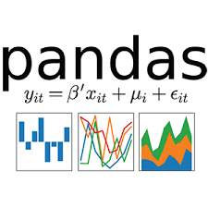
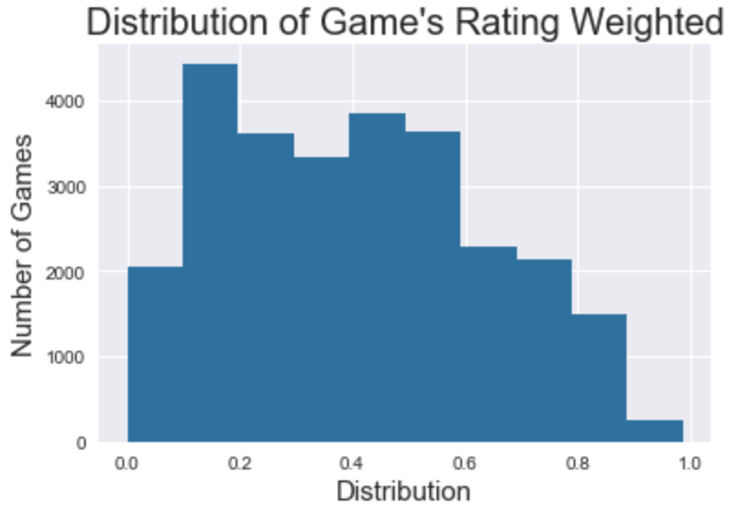
What will I Predict?
Engineered labels using Steam Community data (Positive, Negative, Weighted number of ratings)
Top 70% of distribution
Binary Classification (unbalanced)
Successful games: | 13.5 %
Non-successful games: | 86.5 %

Slide 5

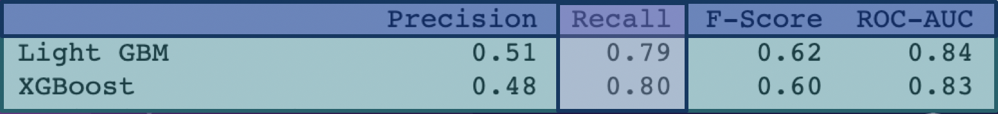
Dataset
27 thousand games
300 Game features(genres, price tags, requirements, etc.)
Preprocessed and Engineered 450 Features
Too many features.
Computing time is slow, and metrics are slightly lower.

Slide 6
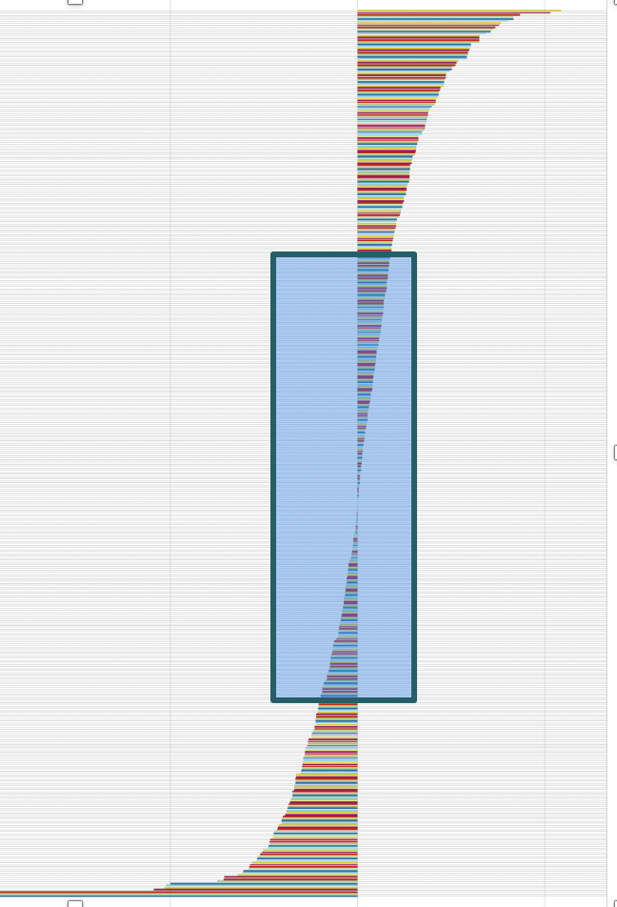
Feature Selection (1)
Logistic Regression Coefficients
Logistic Regression with Lasso regularization
Took out coefficients with absolute values at 0 or close to 0
450 Features down to 350
Coefficient values
Features

Slide 7
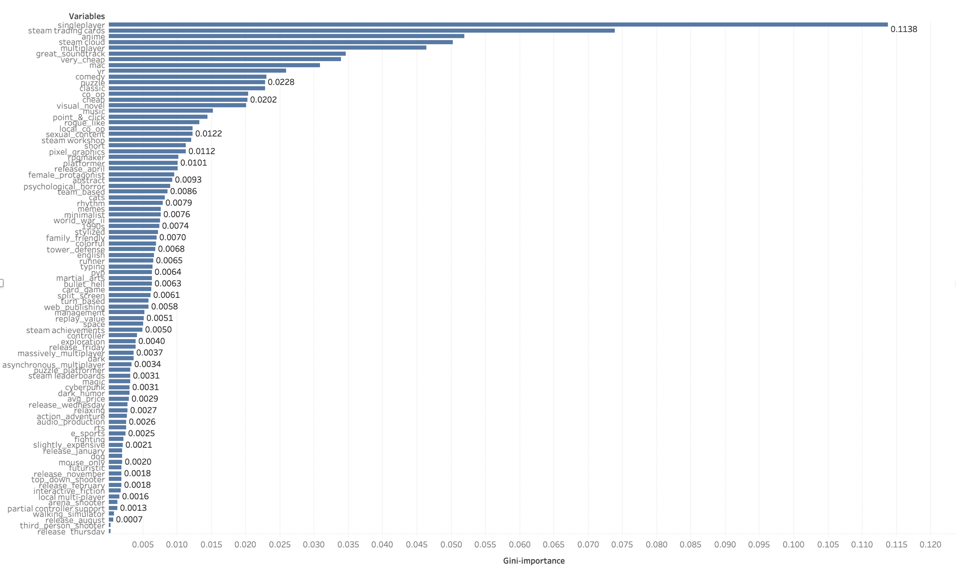
Feature Selection (2)
XGB Feature Importance
XGB Feature importance
350 Features reduced to 100
Lots of features still..
Features
Coefficient values

Slide 8

Model Selection
Cross - Validation
Train Set 80%
Test Set 20%
Used Random OverSampler, Smote, and Adasyn
Grid Search
Stratified K-fold CV K=5
5
Predict best model
Train Set 80%
validation Set 20%

Slide 9
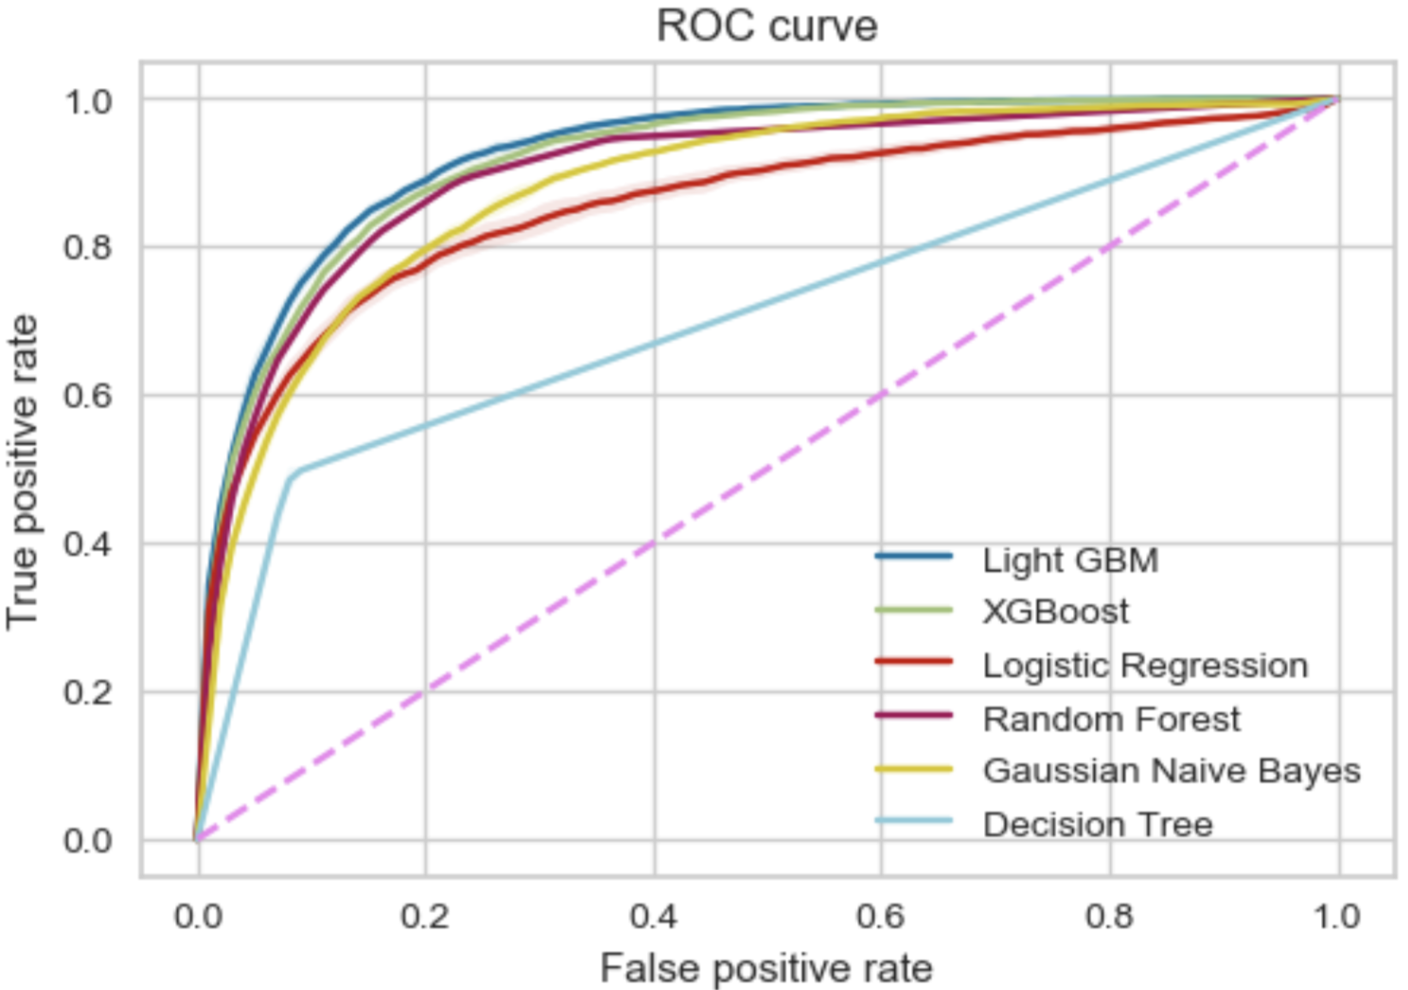
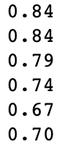

ROC Curve
Top 2 algorithms:
XGBoost and Light GBM

Slide 10
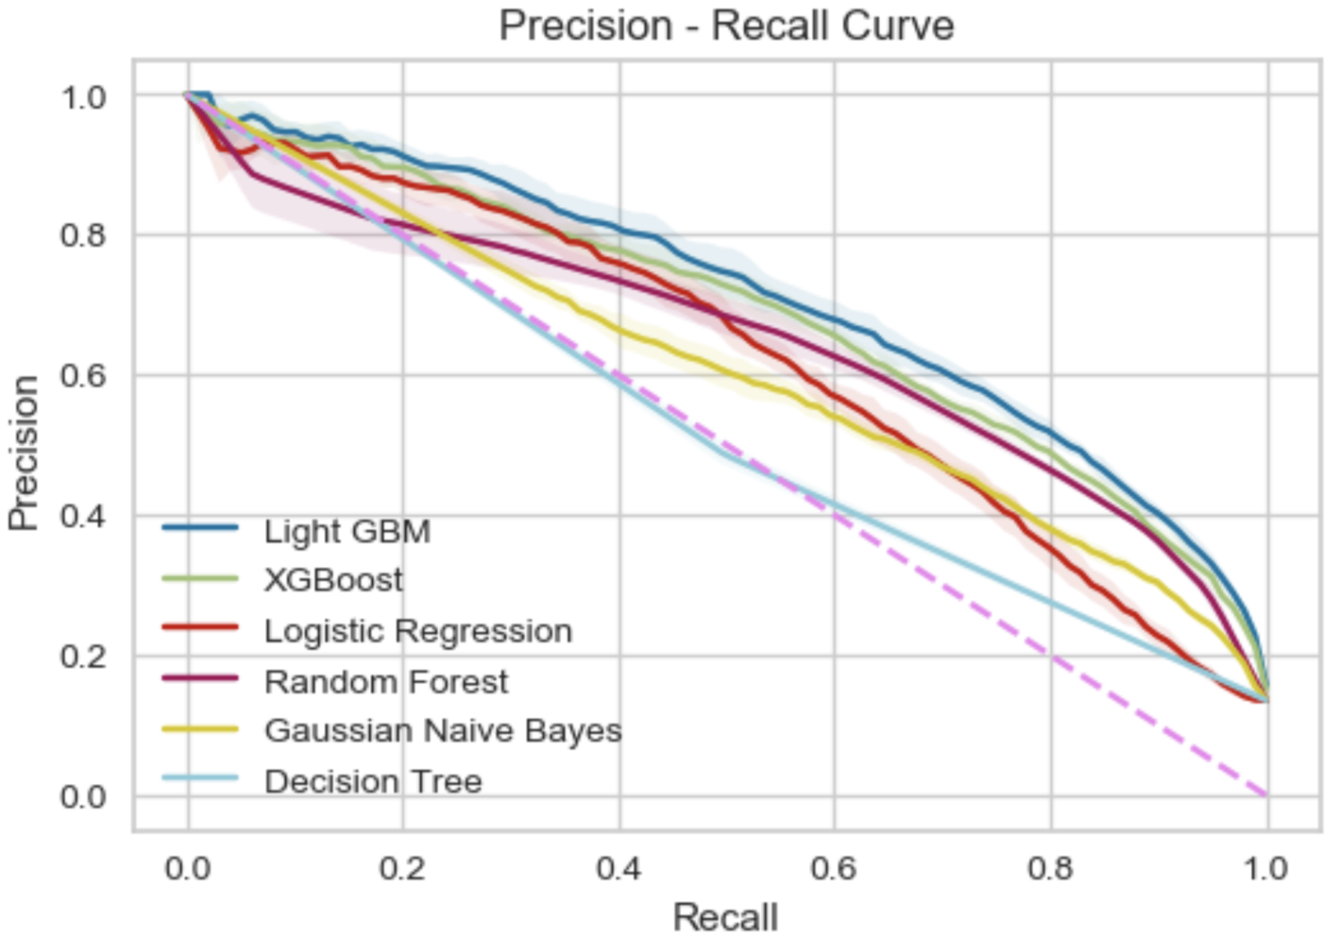
Precision Recall Curve
Top 2 algorithms:
XGBoost and Light GBM

Slide 11
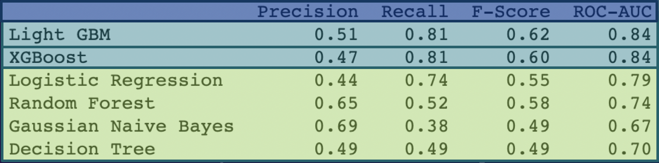

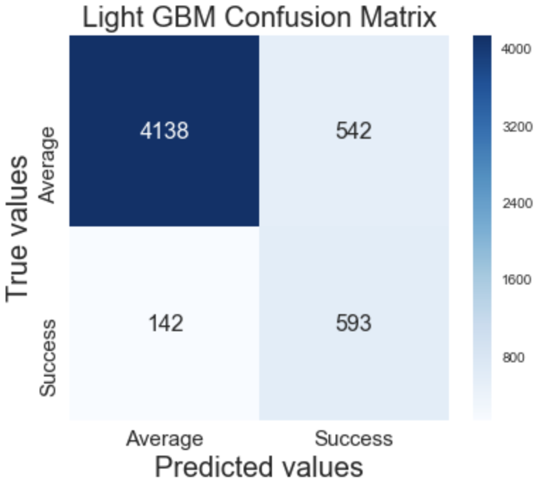


Slide 12

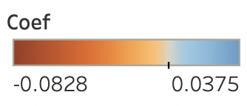
Success/Fail Features
Price: 10-20$
Price: 0-10$

Slide 13
Thanks!
ANY QUESTIONS?

Slide 14
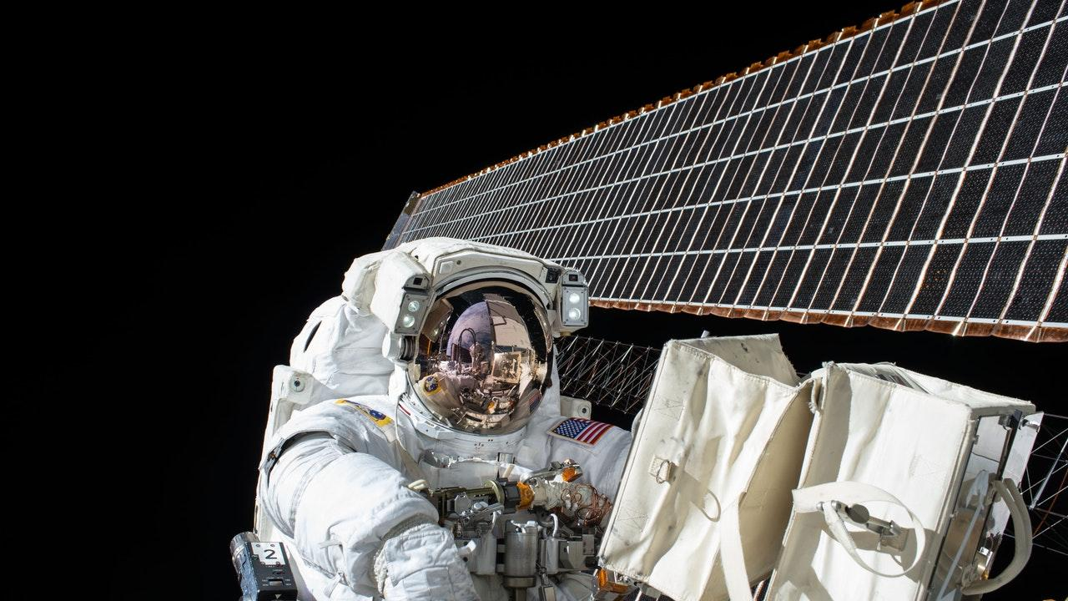
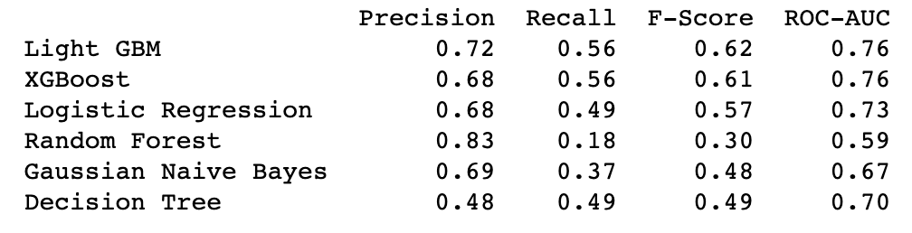
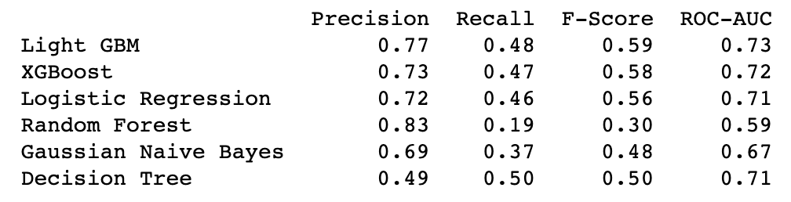
80%
85%

